Slide 1

Balanced scorecard slide 1
EXECUTIVE SUMMARY
Airline Safety Analysis
Swetha Chamala
This Photo by Unknown Author is licensed under CC BY-SA

Slide 2
Balanced scorecard slide 2
Overview
Safety
Looking back
Financial data
Affordability
Conclusions

Slide 3


Balanced scorecard slide 2
Which is safer? – Flying or Driving
723869
Total fatalities: year 2000 - 2018
778
Data from NTHSA (National Highway Traffic Safety Administration), Aviation Safety Network and Airlines for America shows that from the years 2000-2018, Vehicle fatalities in the US are over 100 fold more than airline fatalities.

Slide 4
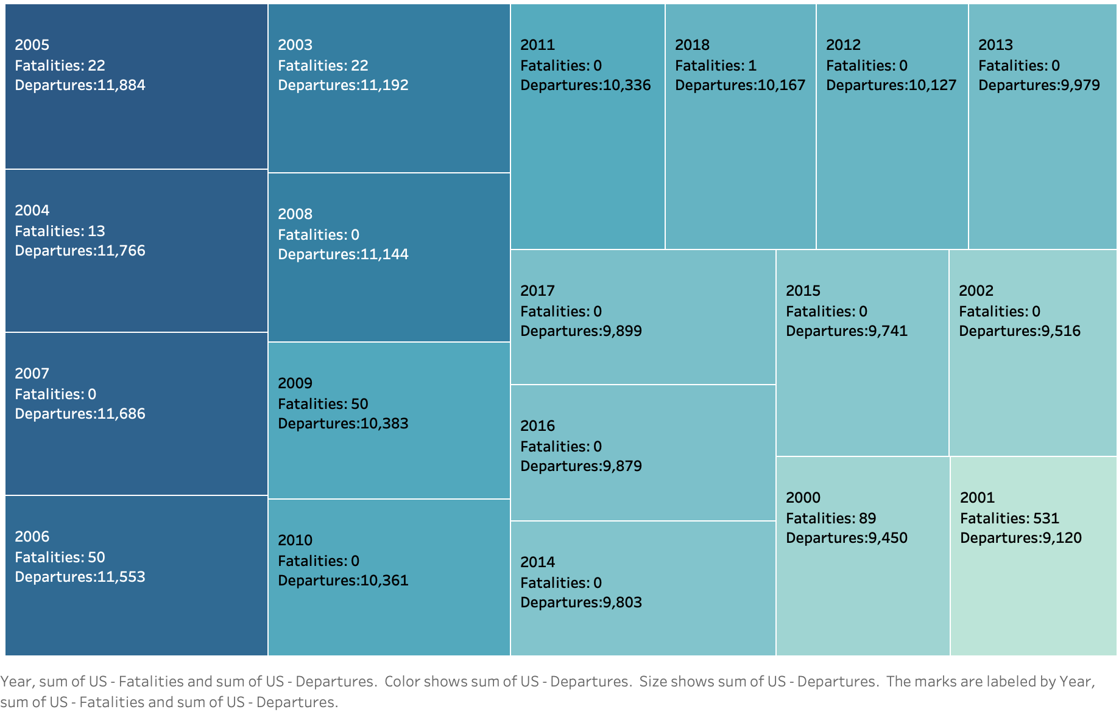
Balanced scorecard slide 4
Looking Back – US airlines Fatalities by number of departures 2000 - 2018
In the US, fatalities
compared to the number
of departure
flights is minimal

Slide 5
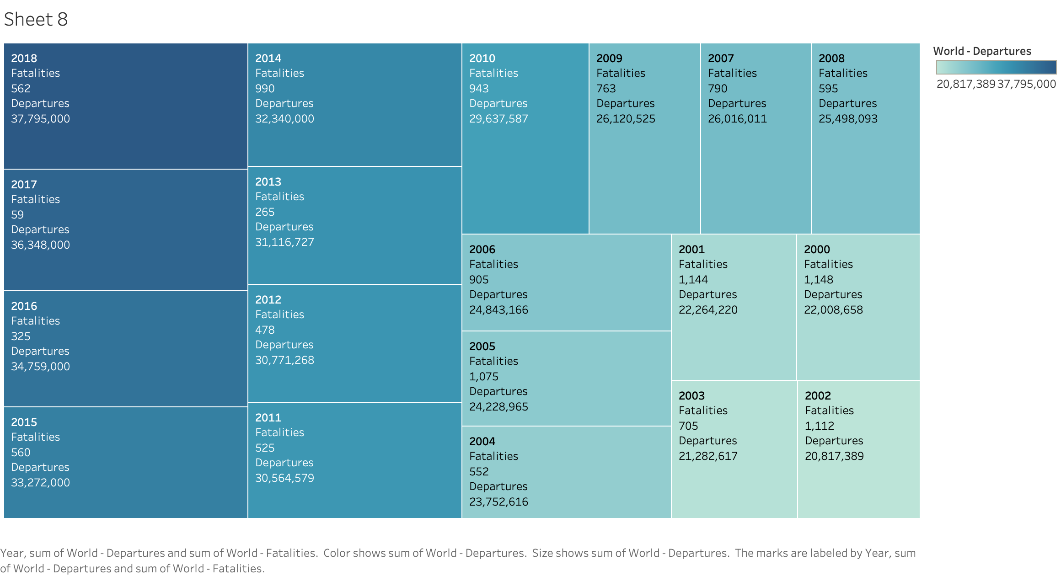
Balanced scorecard slide 4
Looking Back – World airlines Fatalities by number of departures 2000 - 2018
Both the US and World airlines data show that airlines are the safest and fastest method to travel from one place to another

Slide 6
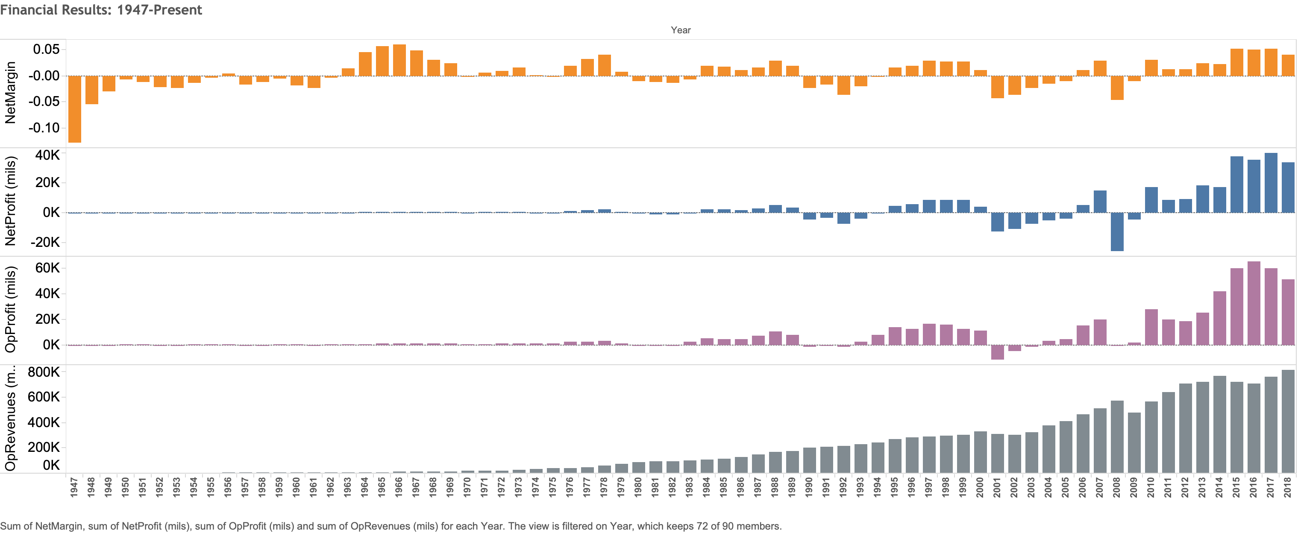
Balanced scorecard slide 4
Financial results – World airlines Net profits from 1947 - 2018
Net profits of world airlines have seen a steady increase from 1947 – 2018 with an exception of 2008 when global financial crisis hit the world

Slide 7
Balanced scorecard slide 4
How affordable is air travel?
Air travel is much affordable now compared to 50 years ago.
With increasing number of airlines, number of operating flights and more destinations, airline travel affordability has increased.

Slide 8
Balanced scorecard slide 4
Affordability
Domestic round-trip airfare
did not change much in comparison
to other expenses over the years

Slide 9

Balanced scorecard slide 5
Conclusion
Statistics show that among the many modes of travel, Air travel is the safest.
With the advancement of technology in the aviation industry, air travel has evolved in many ways
Strict airline regulations and improvements in air traffic control technology have ensured additional safety to travel around the world
The total US airline fatalities from 2000-2018 are 778 and World airlines fatalities during the same years are 13,496. That is a 7-fold difference. However, total fatalities caused by driving vehicles in US from 2000-2018 are 723,869. That is roughly 900 times more fatalities compared to airline fatalities in US. There is a clear distinction that vehicle fatalities are higher.

Slide 10
Balanced scorecard slide 10
THANK YOU!
Questions?
This Photo by Unknown Author is licensed under CC BY-SA

